Slide 1

Assignment 3: Concept Video
Team 2: Seamus, Fred, Jailia, Ashton

Slide 2
01
02
03
04
Problem + Solution
Market Research
Values in Design
Project Name and Value Proposition
05
06
07
08
Tasks
Storyboard
Appendix
Concept Video

Slide 3
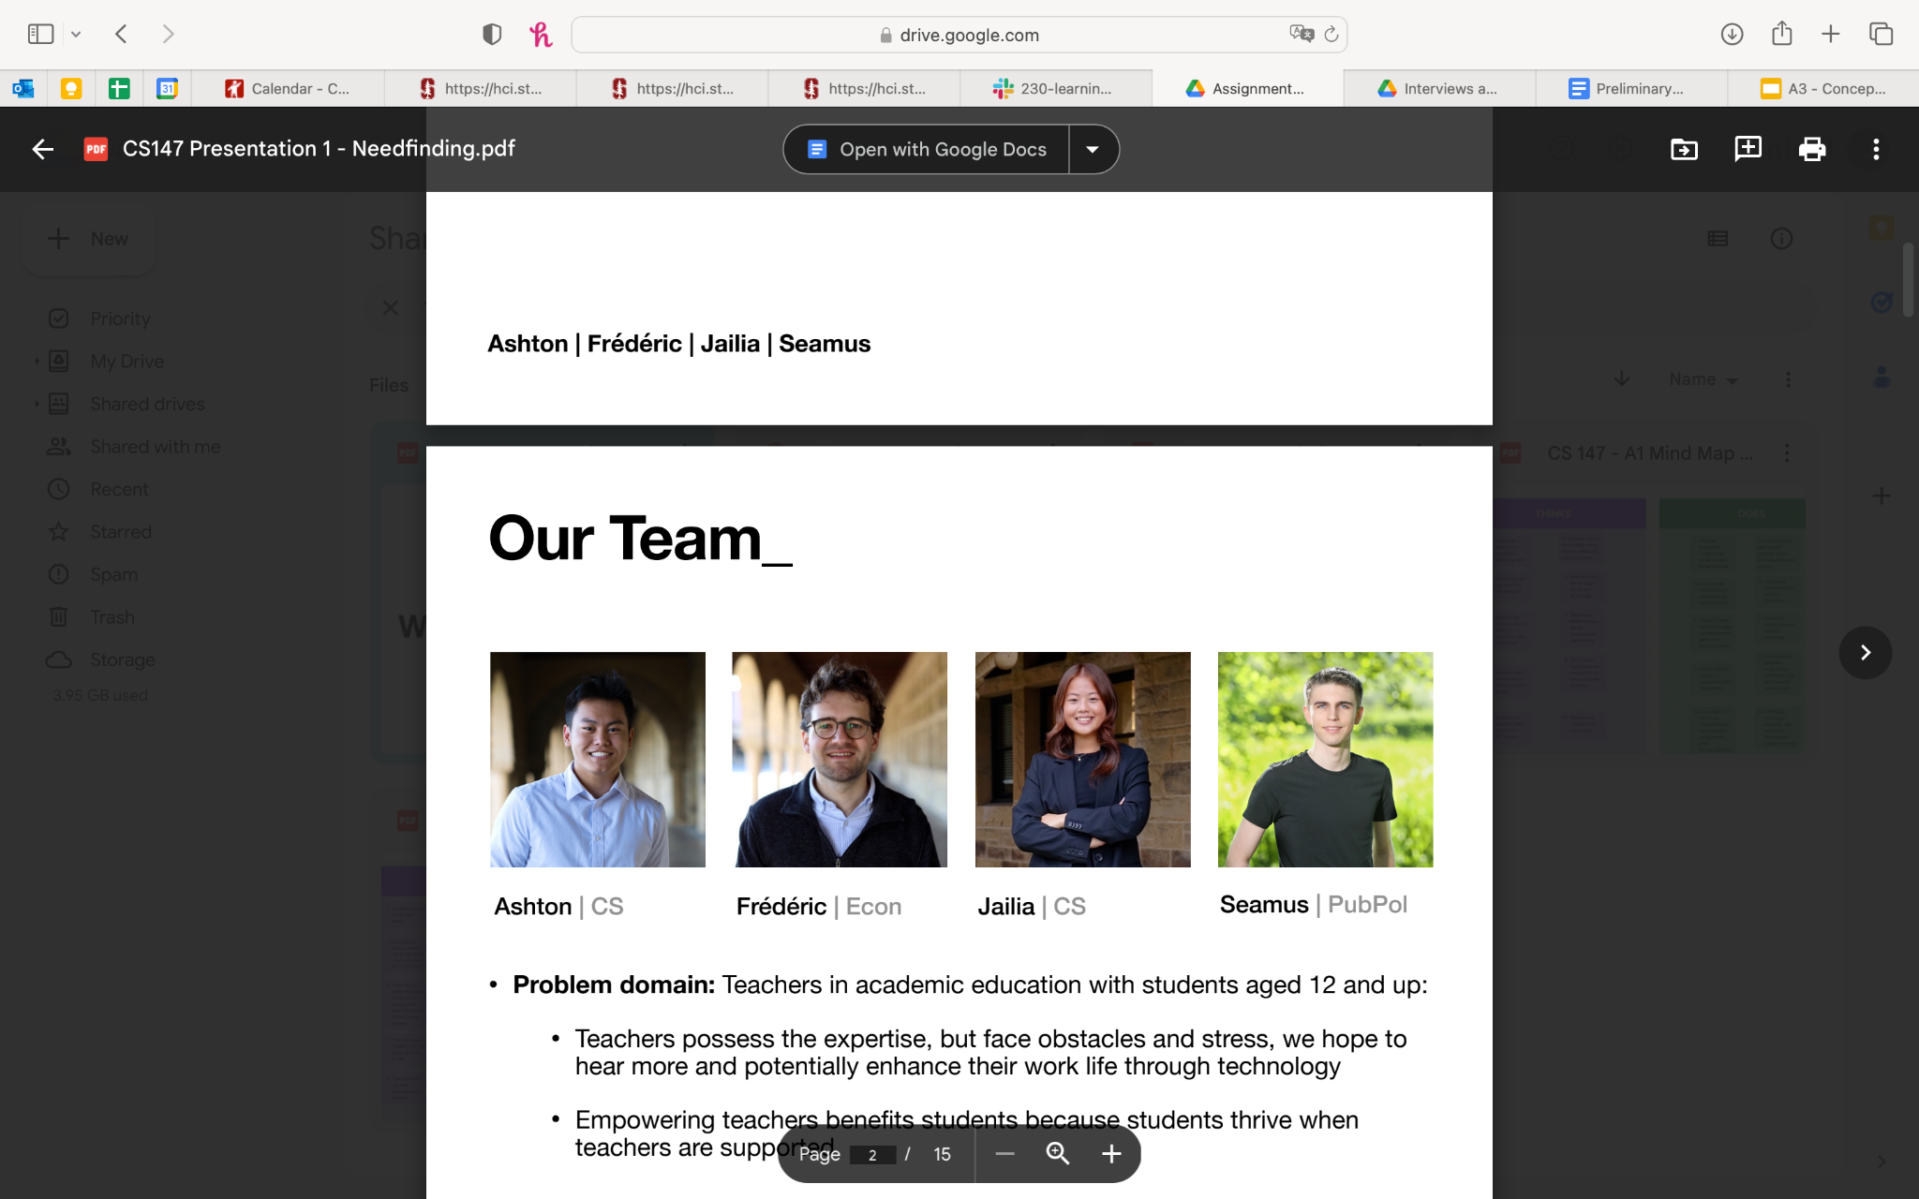
Our Team
Seamus
Fred
Jailia
Ashton
Public Policy
Economics
Computer Science
Computer Science

Slide 4
Project Overview

Slide 5
Going Forward
Week 3 Feedback
Week 3-4 Weekend
Beginning of Week 4
Week 4 and beyond
Team members deliberated individually
Building application for office hours and student grouping
Recognized the ethical implications of peer flagging for teacher attention
Discussed the pros, cons, and excitement surrounding the remaining solutions
Notes:
Want to highlight decision making process since last week
Used the feedback from A3 presentation to reconsider the peer revision solution
Recognized the ethical implications of flagging work as “needing attention” and only allowing a few students to receive feedback
Recognized that students also have little free time to willingly use peer feedback application, would need to be incentivized
Deliberated individually over the weekend
Completed brief market research with the three solutions – researched current applications serving similar purposes/user bases, compared with our solution ideas
Eliminated peer revision solution
Discussed the pros and cons of two remaining solutions
Writing assistant tool could serve as Chrome extension, feasible for computers/laptops
Office hours tool could serve as mobile app with possibility of additional desktop analytics for instructors
Both tools appear relatively equal → matter of personal interest and excitement
Decided to move forward with application for managing and scheduling office hours and student grouping
Recognized the need for such application in terms of our own experiences with office hours
Expanded user base to university students as well, but still applicable to high school students, as per our original user base
Practical issue with personal connections between different group members

Slide 6
Experience Prototype Takeaways
Three questions:
Are long wait times a problem?
Yes. All students interviewed had been waiting for a long time. Removing the wait could be game-changing.
Did many students have the same question?
Yes. All students interviewed had a question in common. Ensuring the TA could speak to them all at once could be game-changing.
Were students able to collaborate to solve their mutual questions?
Yes. The students interviewed were already working together. Our app probably needs to facilitate Teacher-Student interactions, not Student-Student interactions.
Notes:
In our interview with J, the Stanford PhD researcher who has years of teaching assistance experience:
UC San Diego also uses their own office hours queue system for CS classes
How do TAs balance their responsibilities as a researcher and supporting students?
How do TAs make learning equitable, given their position as a recent grads who may have had similar experiences?
In our interview with P, the teacher at Harker who teaches AP classes:
His students wait for hours after school to talk to him ⇒ how does this affect the students’ time? The parents’ time? P’s time such that P may feel obligated to stay late but may also want to genuinely support the students?
Connecting the user bases together:

Slide 7
Problem and Solution
I wonder who else is working on this problem.
Your TA is discussing Question 2 now!
PROBLEM:
Wait times for office hours are frequently long across all levels of education. Teachers wind up managing long queues and answering the same question over and over again.
SOLUTION:
A comprehensive office hours tool that groups together students with the same question and notifies them all when the teacher is ready to meet.
Notes:
What is the problem we’ve identified?
Instructors are overwhelmed by the number of students who need support, but they can’t possibly meet with everyone
Instructors are frustrated that they have to reteach the same concepts at the same office hours multiple times
Students are concerned they won’t be able to find a time that fits both their schedule and their instructors
Students are worried office hours will be too busy
Students don’t have a way to sign-up for office hours at a designated time
How are we solving these problems?
Instructors are able to manage their office hours availability, provide a schedule for student sign-up
Instructors can teach the same concepts far fewer times if they teach it to groups rather than all 1-on-1’s
Instructors are able to fit more students into their schedule, thus are able to support more students
Students can be productive while waiting for their turn at office hours
Students are encouraged to collaborate with peers, teaching and learning from one another
Students do not have to worry about finding the peers to collaborate with
Students maintain autonomy by being able to choose how they want to learn (individually, group setting, meeting with the instructor 1-on-1 or in a group)

Slide 8
Name, One-liner, Value Proposition
sameQ
We chose this name with the aim of immediately conveying the app’s purpose to users. The “Q” represents both questions and queues that users may share.
“Questions paired, knowledge shared.”
We crafted this one-liner to succinctly communicate the app’s capabilities of promoting collaboration and productive use of waiting time during office hours.
Unlock the potential of collaborative learning and and efficient office hours with sameQ. Empowering educators to offer flexible office hours and enabling students to seamlessly book individual or group slots while facilitating connections with peers, sameQ helps to foster a vibrant learning community and enhanced academic success.
Notes:
Developing the name sameQ:
Name is explanatory of the app’s purpose
Students tend to have the “same” “q” or same question, thus students can be put into the same spot in the “queue”
Wanted to stray away from having the word “queue” appear in the name
Wanted a short yet catchy name that wouldn’t require a lot of work to verbally say
Developing the one-liner:
Considered the majority user base → students
Connected majority user base to the app’s purpose
Wanted to emphasize the significance of peer collaboration that both enhances academic performance and makes office hours more productive overall
Value proposition:
Wanted to acknowledge both direct stakeholders: instructors and students
Provide brief explanation of app’s purpose and app’s long term goal of community and academic success

Slide 9
Market Research

Slide 10
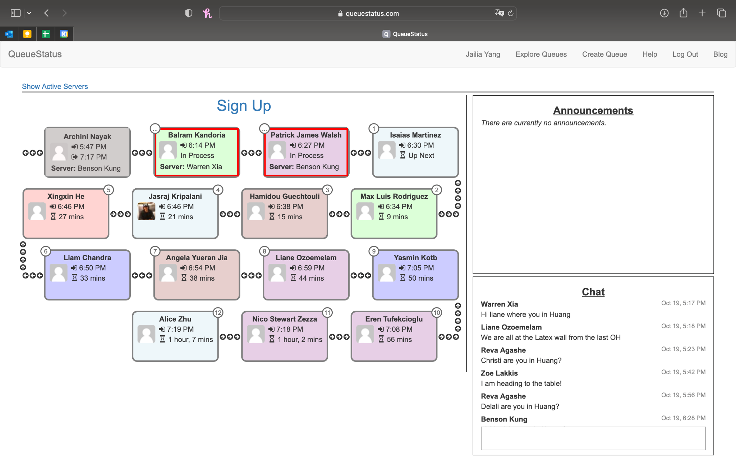
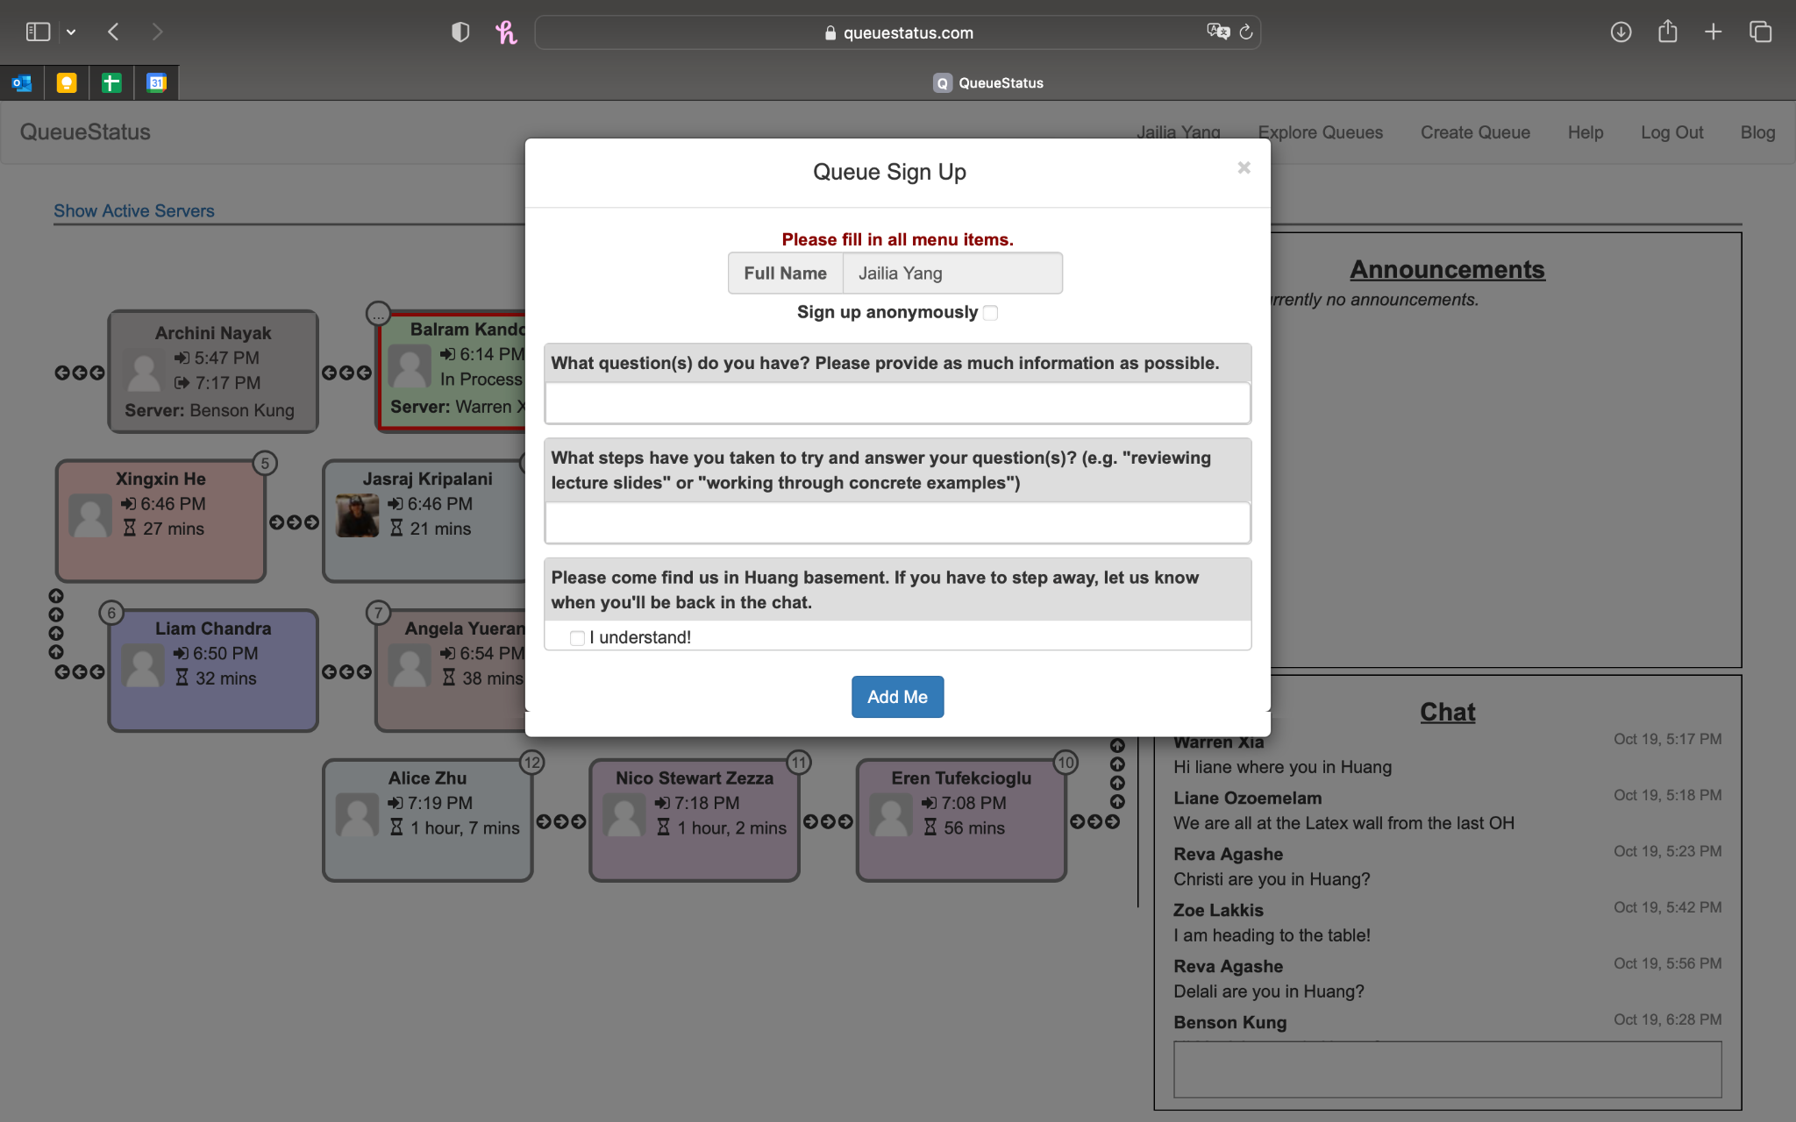
QueueStatus

Slide 11
QueueStatus
What’s worked:
Instructors able to post announcements to all students
Students can sign-up anonymously
Chat option for everyone to use
What hasn’t worked:
Inconsistent notification settings
No option for personal or group chats
No mobile notifications limit convenience
What makes sameQ unique:
sameQ allows students to sign-up for an office hours slot either individually or with a group. They can coordinate this by seeing who has the same question as them, or using the chat to send a direct or group message. It will also use mobile notifications for convenience.

Slide 12
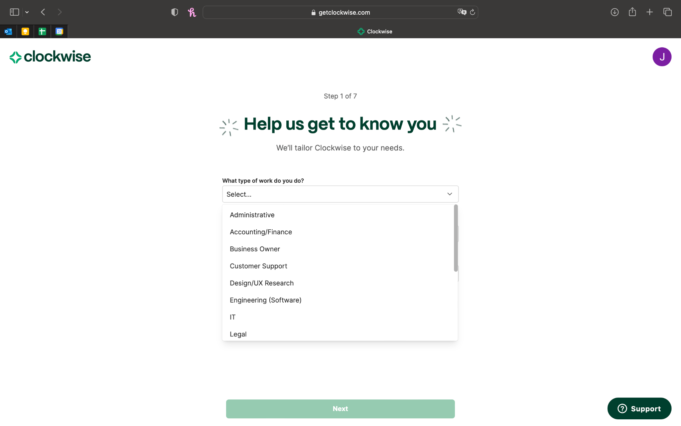
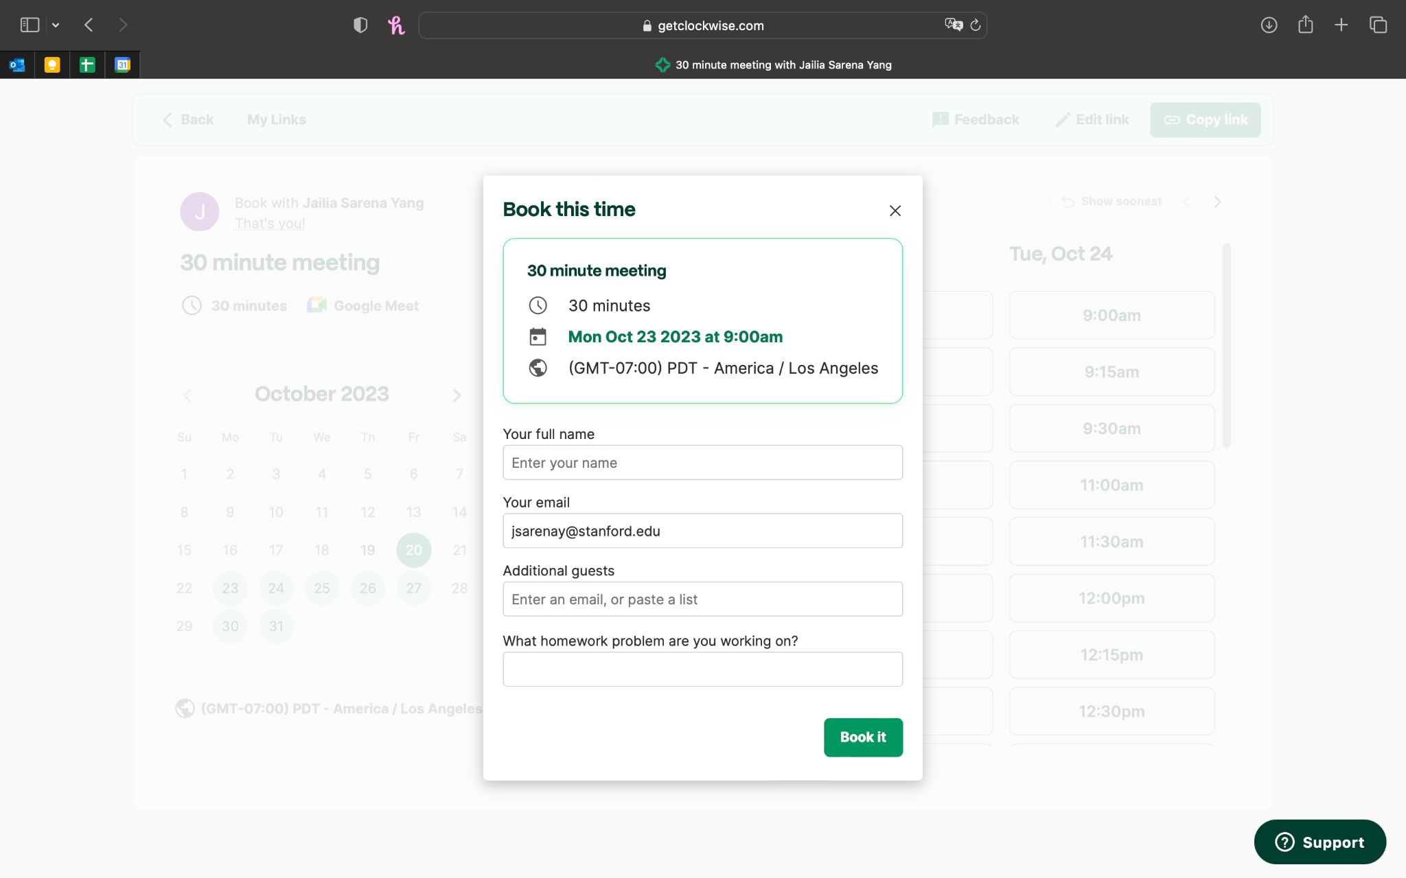
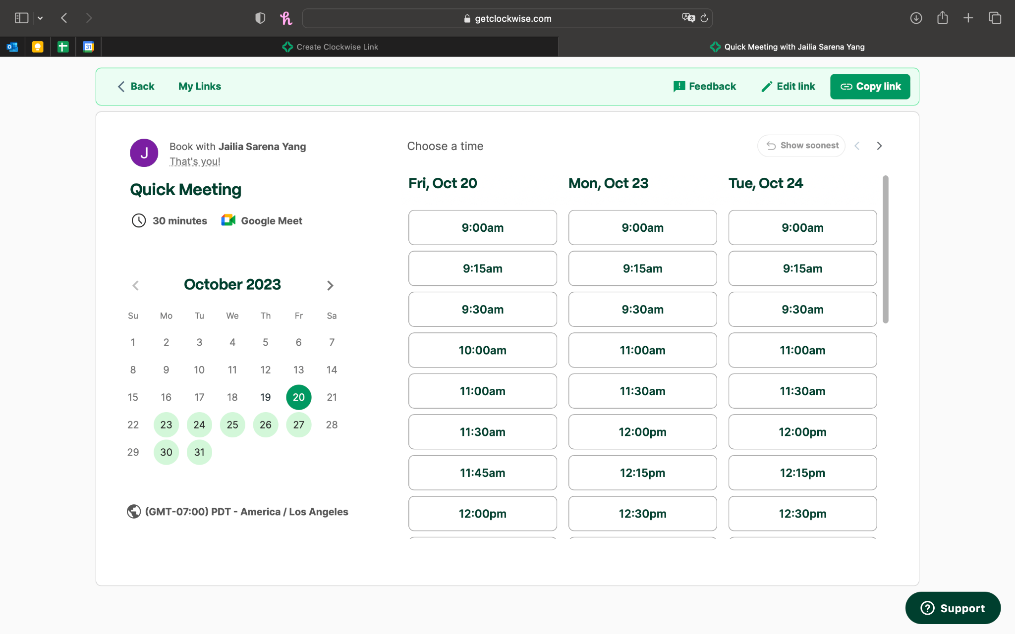
ClockWise

Slide 13
ClockWise
What’s worked:
Simple UI/UX
Instructors can add a personalized question during sign-up
What hasn’t worked:
Unable to sign-up in groups
Strictly an extension of Google Calendar
No option to sign-up as educator or student
What makes sameQ unique:
sameQ is not an browser extension, but rather an individual application that students and instructors can conveniently use from their mobile devices and tablets.

Slide 14
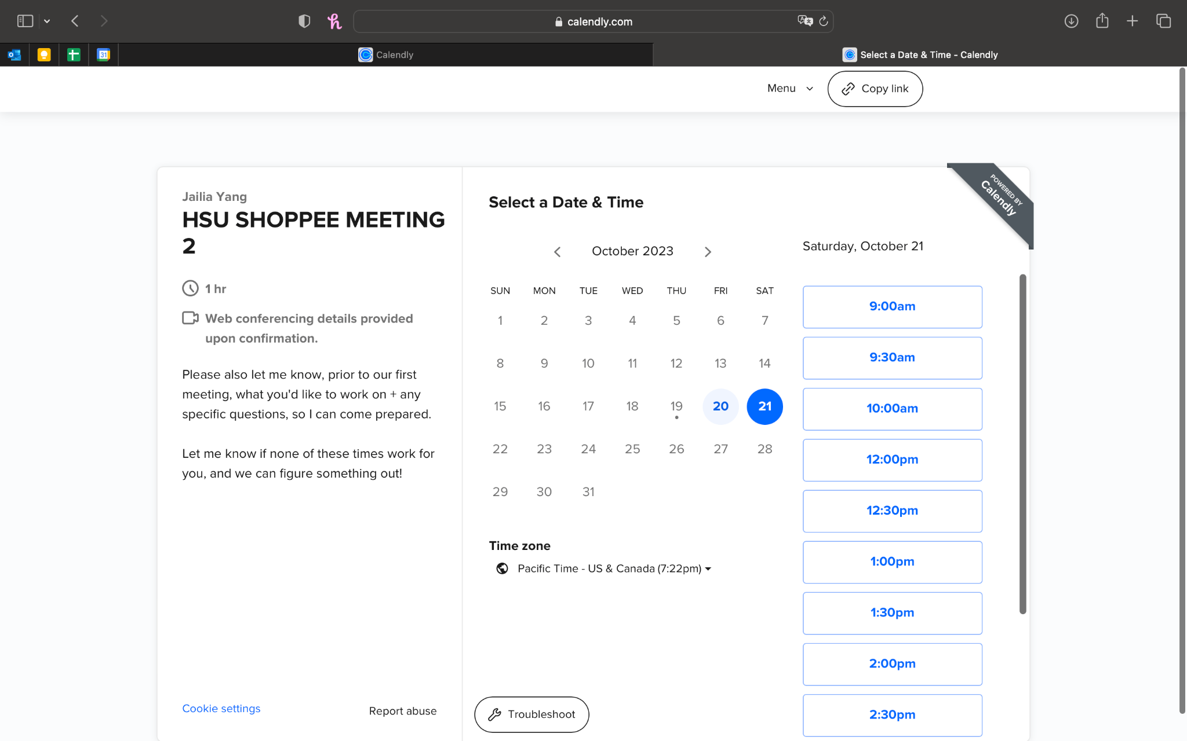
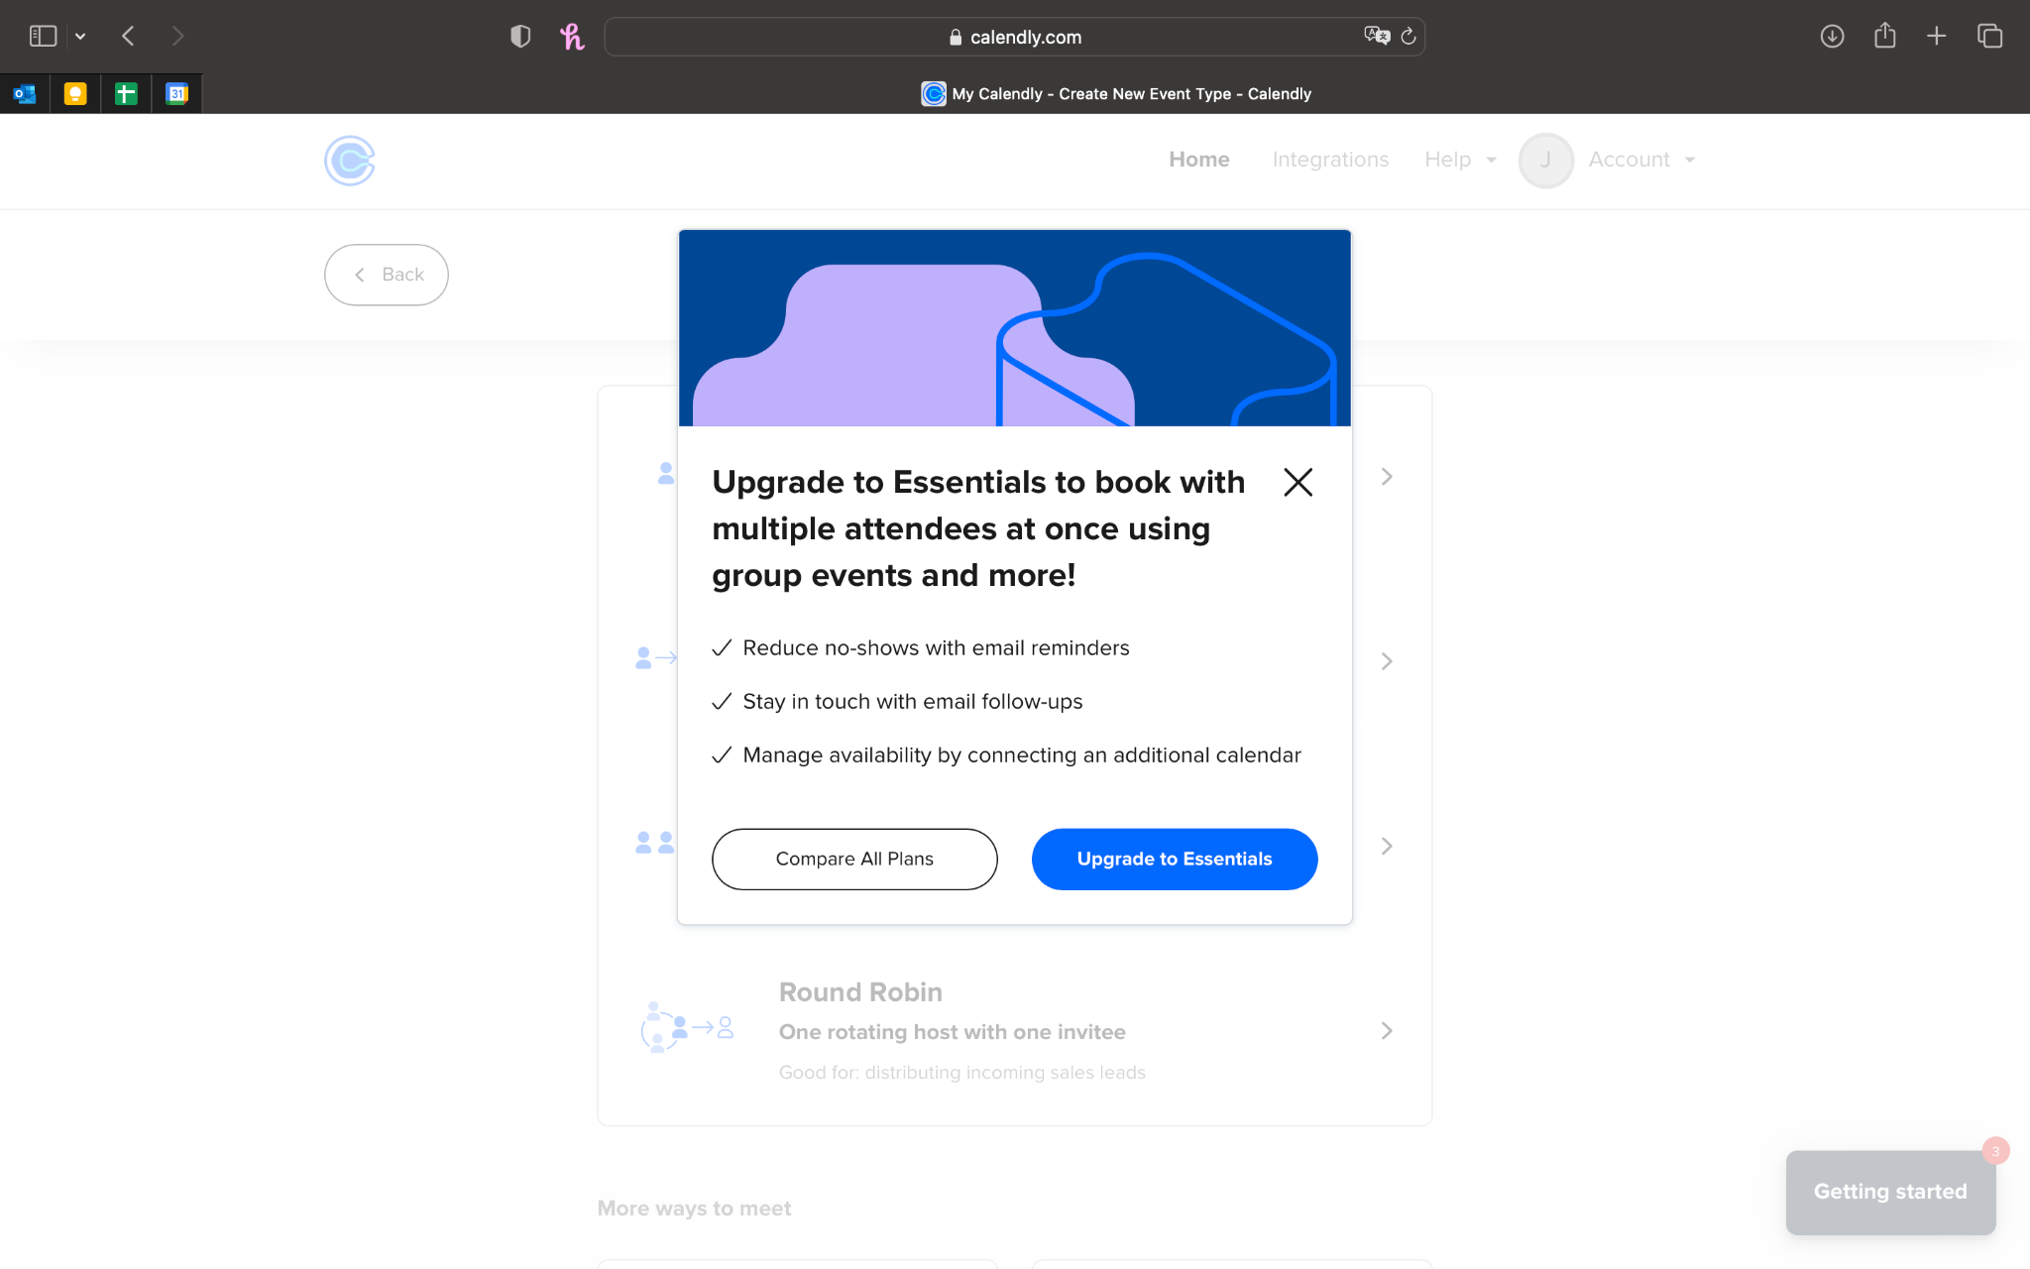
Calendly

Slide 15
Calendly
What’s worked:
Integrated email and text message reservations into calendar
Multiple booking types (1-on-1, round robin, group, etc.)
What hasn’t worked:
Most features (like group scheduling) require payment
Difficult UI/UX design
Time-block-scheduling.
What makes sameQ unique:
SameQ will feature straightforward configuration and user-friendly accessibility to ensure a seamless user experience. A queue rather than time block system will more easily fit with an environment where meetings frequently go short and long.

Slide 16
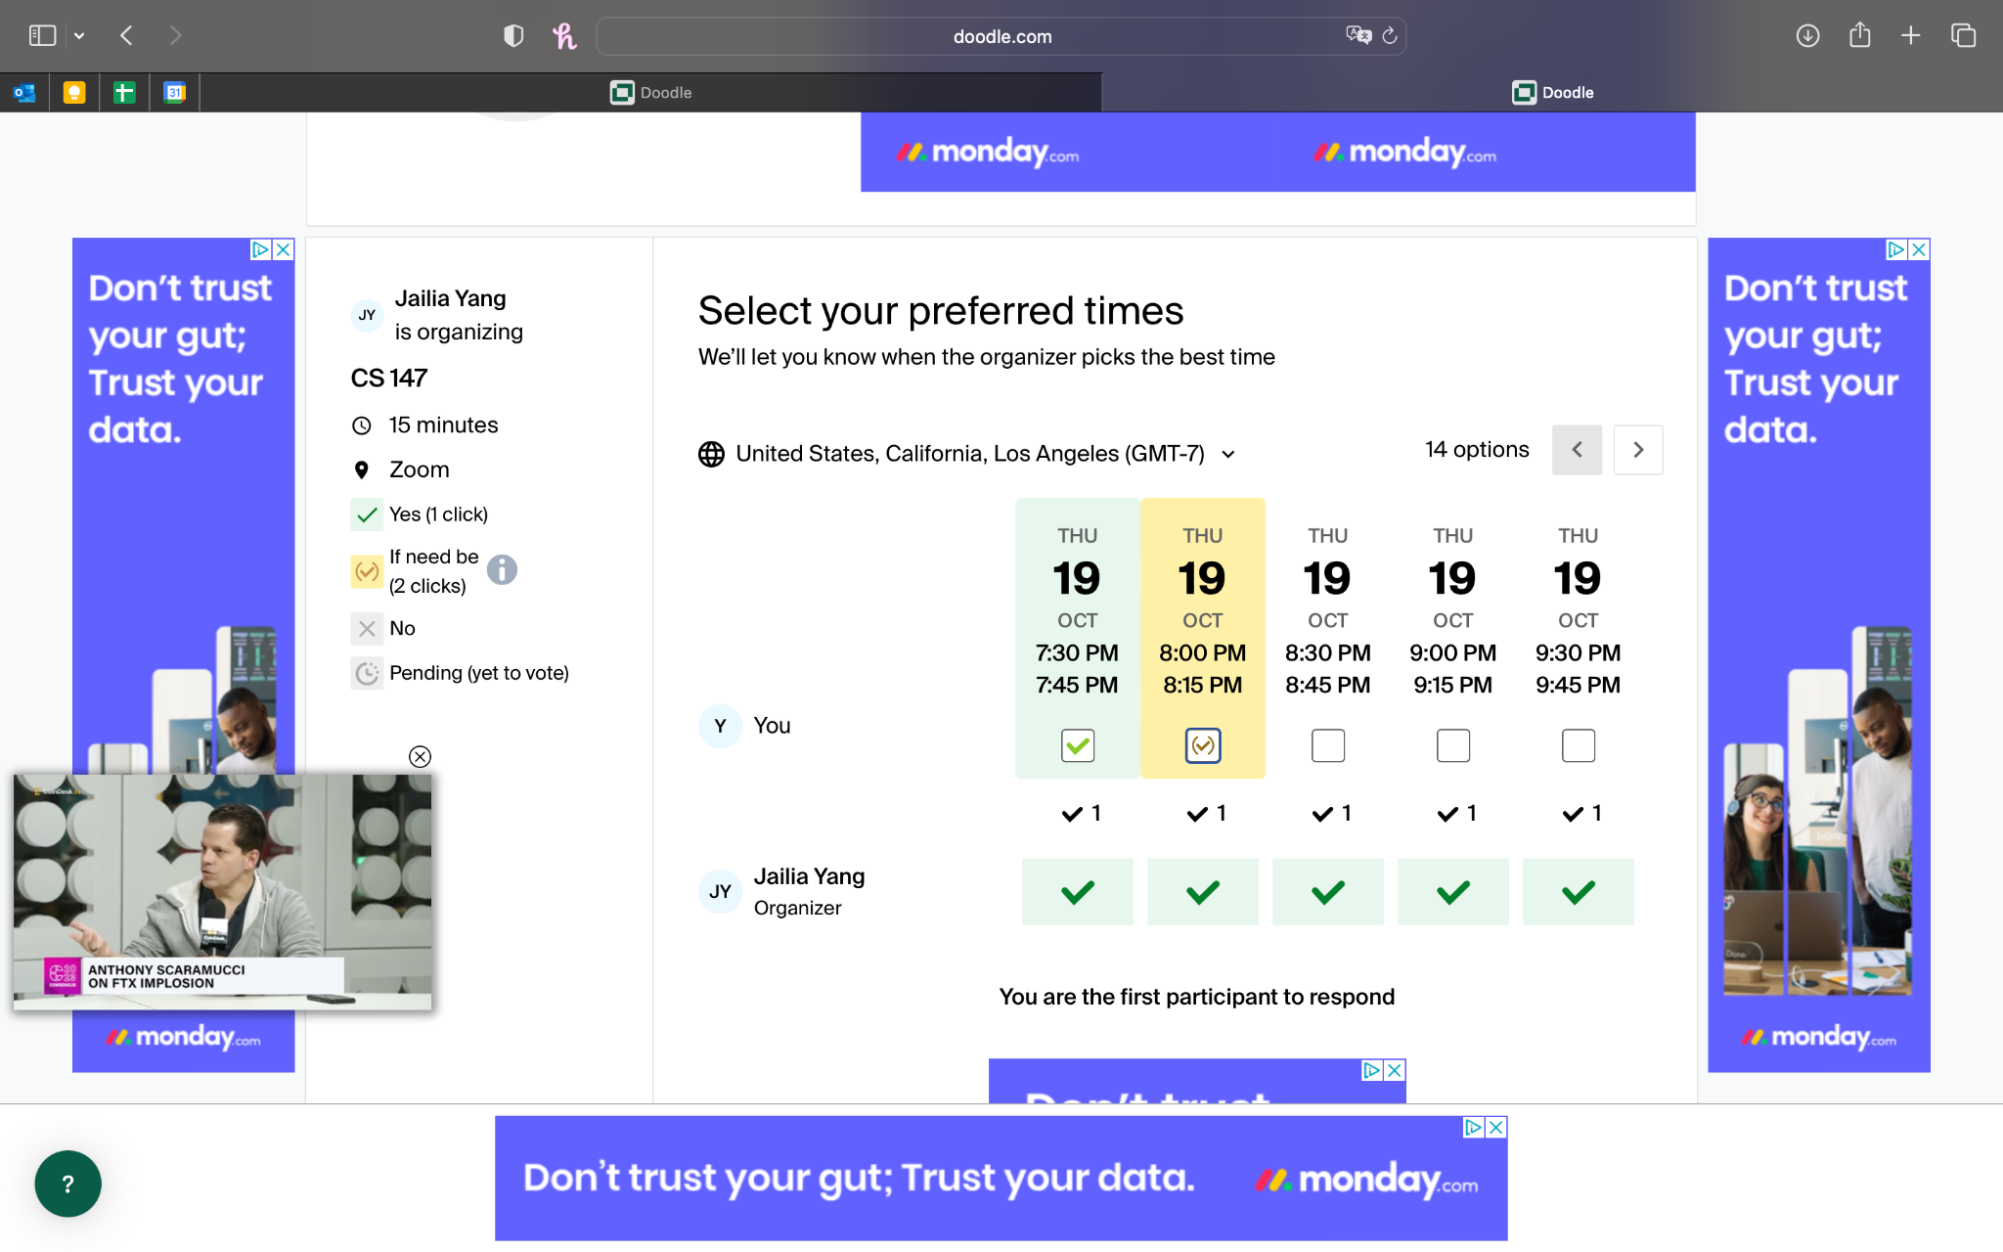
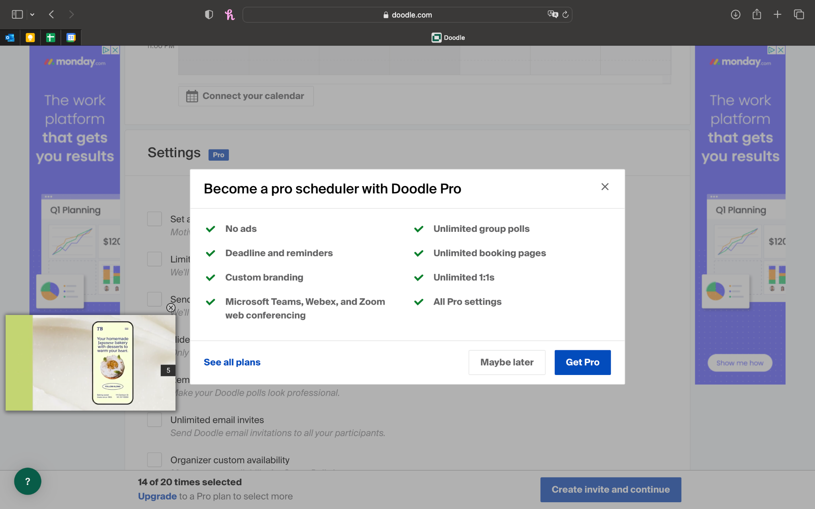
Doodle

Slide 17
Doodle
What’s worked:
Create a booking page without signing up or logging in
Connect with Google or Outlook calendars
What hasn’t worked:
Lots of ads
Most features (like setting a deadline to respond by) require payment
Simply a scheduling tool, not fit for real-time notification/adding a question
What makes sameQ unique:
sameQ will not bombard users with advertisements that interrupt user learning or instructor scheduling of events, and allows easy adding of questions (and, in the future, specific aspects of questions) and automatic grouping of questions so that instructor time can be used more efficiently)

Slide 18
sameQ vs. Competitors
 | sameQ | QueueStatus | ClockWise | Calendly | Doodle
Sign up individually | ✅ | ✅ | ✅ | ✅ | ✅
Easy, free grouping by topic | ✅ | ❌ | ❌ | ❌ | ❌
Chat option | ✅ | ✅ | ❌ | ❌ | ❌
Designed for educators and students | ✅ | ✅ | ❌ | ✅ | ❌

Slide 19
Values in Design

Slide 20
Stakeholders
DIRECT
Instructors: Schedule and manage OH, streamline tasks and communication, use data to see what their students struggle most with
Students: Sign-up for OH, facilitate collaboration, communicate with peers and instructors
INDIRECT
Parents: Involved in child’s education, communication with instructor
Academic advisors: App serves as guidance for student success
Administrators: Managing app usage, security and privacy

Slide 21

Ethical Implications
The Superfan:
How would a community of your most passionate users behave?
Assumption that students behave respectfully
Balancing use of office hours and other methods
The Service Dog:
If your product was entirely dedicated to empowering the lives of an underserved population, what kind of impact could make?
Fair resource allocation
Student autonomy and flexibility
Notes:
The Superfan:
Relies on the assumption that students will behave respectfully and responsibility if they are in a collaboration group together
Must address the concern of cheating, plagiarism
Must adhere to the collaboration policies of individual classes/instructors
Challenge of students solely using office hours
Students may not attempt the assignment because they know they can show up to office hours and receive help from either instructor or peers
Students may only attend office hours and not utilize other methods like independent study or tutoring
The Service Dog:
Helps provide fair resource allocation for students
Students with disabilities are able to sign-up from home (or anywhere else)
ie: a student with ADHD may have trouble focusing in the office hours location because it is so loud, so they sign-up at home and arrive when it is near their turn
If instructors are allowing students to attend office hours virtually, it is easy to insert links to Zooms/Google Meets to be even more accessible
Students are able to choose if they want to join a collaboration group, wait on their own, ask a question with their group, or ask a question on their own
Ie: a student may not want to automatically be put into a group setting because they prefer to work on their own
Ie: a student who has trouble meeting new people may appreciate the option to be put into a group setting so they don’t have to find the peers and start conversation in order to receive help

Slide 22
Tasks

Slide 23

Tasks
Simple (1)
Moderate (2)
Complex (3)
Get a notification when your question is being answered.
Find and join your office hours page.
Invite other students to join your signup page
Notes:
Simple: This task can be defined as simple because it is what every student will experience. Whether they ask a question and choose to meet with the instructor individually or in a group, the student will receive a notification. It’s as easy as reading the notification and finding the location of the instructor.
Moderate: This task can be defined as moderate because it can be challenging to find your instructor’s course page. Most instructors may provide a link, thus eliminating this task, but if the instructor doesn’t provide a link to the office hours schedule, then it can be overwhelming for the student to find the page themselves.
Complex: Only an experienced user of the app will be setting up and managing the office hour page. These experienced users will likely be the instructors and teaching assistants only.

Slide 24
Storyboard and Concept Video

Slide 25
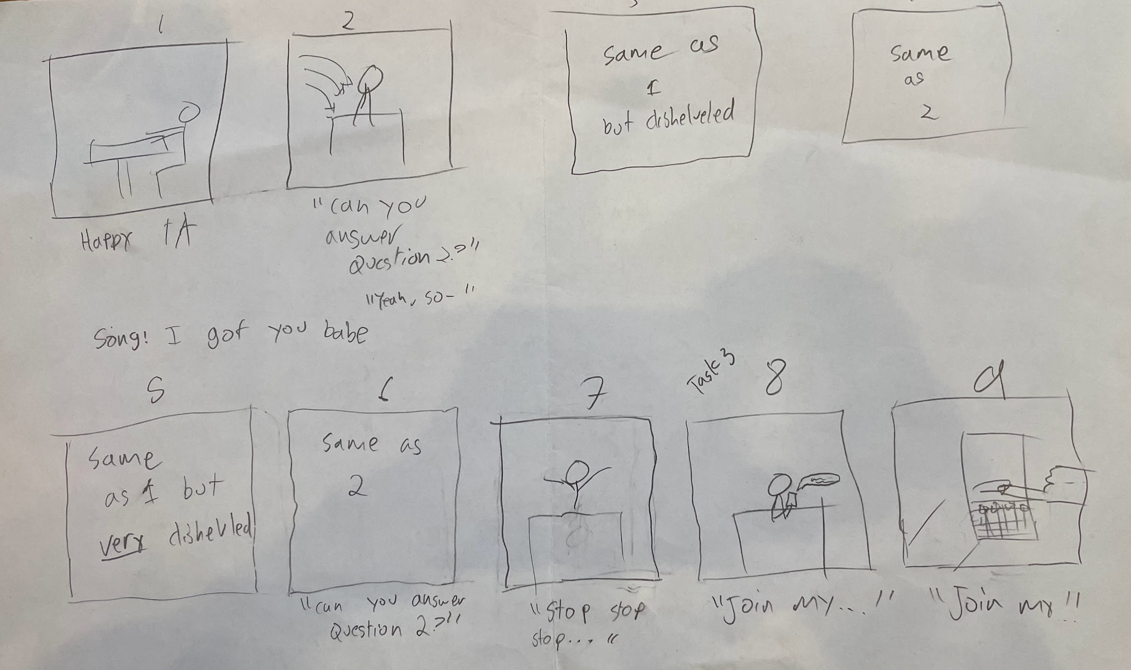
Storyboard
Task 3
Notes:
Steps we took to create the storyboard and concept video
Brainstormed our goals for the concept video
Wanted to make it funny
Inspired from concept videos in class: pizza scene, funny “jump-scare” scene after a black screen
Wanted to keep it as short as possible given the time constraint
Decided on a general story line:
Set the Scene/make problem obvious: Instructor gets asked the same question over and over again
Students wait around in a loud/busy place/classroom instead of being able to focus on something else
TA gets more and more tired of it, eventually loses hope and luckily remembers there’s SameQ
Send out same Q Link -> everyone gets a notification
Group office hours Can Happen, saving everyone’s nerves, and time, and bringing students together for easier collaboration even outside of office hours
Solidified story line by considering camera shots, specific scene cuts, who we would need in the video
Checked out different locations on campus: identified GSB as ideal as it’s like an always-busy classroom, and easy to find additional people for our OH queue
Gathered other individuals to be in the video
Shot the final video
Completed a series of video revisions

Slide 26
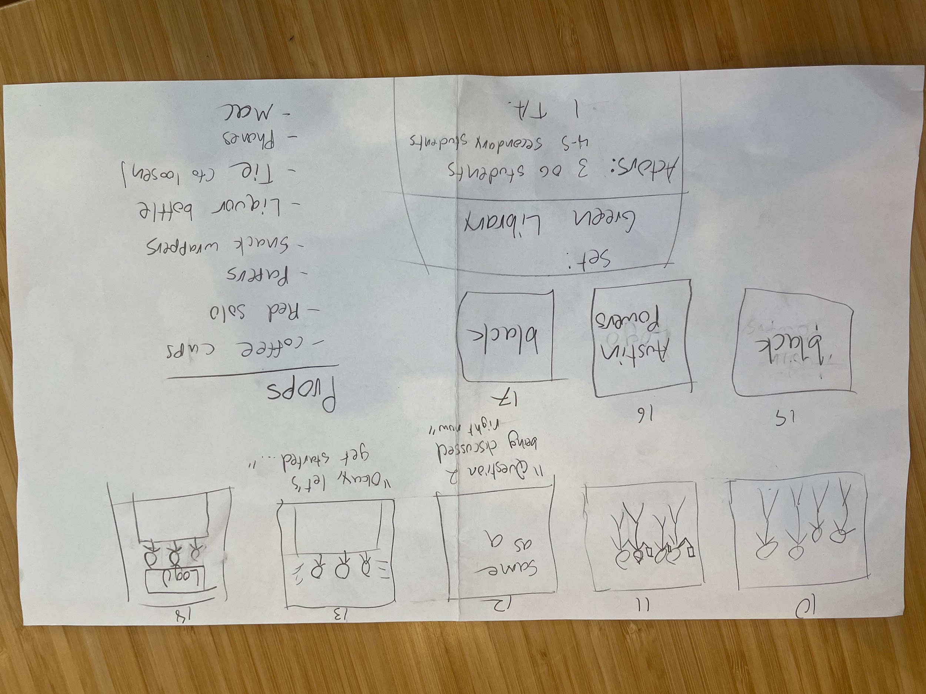
Storyboard
Task 2
Task 1
Notes:
Steps we took to create the storyboard and concept video
Brainstormed our goals for the concept video
Wanted to make it funny
Inspired from concept videos in class: pizza scene, funny “jump-scare” scene after a black screen
Wanted to keep it as short as possible given the time constraint
Decided on a general story line
Solidified story line by considering camera shots, specific scene cuts, who we would need in the video
Gathered other individuals to be in the video
Shot the final video
Completed a series of video revisions

Slide 27

Concept Video
Notes:
Title is a link in case embedded player doesn’t work

Slide 28
Appendices

Slide 29
Appendix A: General Market Research
Solution 1: QueueStatus
It would be game-changing for students to not worry about missing their opportunity while making use of the time they spend waiting for their turn.
HMW make the wait for office hours just as much an opportunity for learning as the time spent with the teacher themself?
Solution: Group students with the same question together, and notify them when they reach the front of the queue
Market Research:
Clockwise: Semi-Smart Scheduling Tool for Personal 1:1 OH, their blog post (https://www.getclockwise.com/blog/office-hours) also highlights some other popular options.
Calendly Scheduling
LeadMonk Scheduling
Bottom Line: Basically all are meeting scheduling apps, no good OH app. I know Cal has their own (according to Julia), and there is QueueStatus.
THOUGHTS: Already exists!
Solution 2: Iterative Writing Process
It would be game-changing for teachers to not have to worry about students using AI to cheat.
HMW allow students to document their writing process and progress throughout an assignment?
Solution: Build a system that supports an iterative writing process where all changes are tracked. Students are required to outline, revise, and reflect on their writing.
Market Research:
One teacher mentioned: https://chrome.google.com/webstore/detail/draftback/nnajoiemfpldioamchanognpjmocgkbg
But just does version history
https://www.techlearning.com/how-to/how-to-prevent-chatgpt-cheating
https://www.joshpeete.com/outsmarting-ai-5-foolproof-ways-to-prevent-students-from-cheating-with-chatgpt-and-ai-technology/
^ Does not mention process platforms, does mention falliability of ChatGPT detectors
https://usingeducationaltechnology.com/online-tools-to-help-teachers-teach-the-writing-process-guest-post/
^ Does not highlight any unified tool-just ones for each part of the proccess
THOUGHTS:
Genuinely new tool
More geared towards original target group!
Solution 3: Peer-Grading
It would be game changing if students could get in-depth feedback on their work without it interfering with her other responsibilities as a teacher like designing lesson plans and meeting one-on-one with students.
HMW direct the teachers' attention to the assignments that need the most help?
Solution: Make peer grading easier and allow students to flag assignments that need help. Identify which students’ opinions to trust most over time.
Market Research:
https://www.peergrade.io/ - Teacher assigns assignment and students grade each other
Feedback Fruits: Students can provide peer feedback based on instructors’ predefined criteria allowing instructors to access student learning analytics
https://www.crowdgrader.org/ - Teacher assigns students with rubric and students grade each other
https://clever.com/library/app/peergrade - Anonymous feedback peer grading
Peer Studio: PeerStudio creates an opportunity to see inspiring work and get more feedback on it. Instructors also tell us that their students enjoy writing, designing and completing assignments for a real audience, and how the benefits of peer reviewing spill over into clearer presentations and more insightful questions in class. (Used by many universities already)

Slide 30
Appendix B: Brainstorming the Name “sameQ”
CanCoRoup
Cangoroo
SameQ
GroupThink
SameQuestion
StudyHerd
StudyHive
ConnectCohort
OfficeOtter
GatherRound
Q&Queue
QCircle
AskTgthr
HourSync
QuestQueue
ScholarSlot
GroupGather
TutorTandem
QueryCluster
OfficeAlign
HourHub
StudySync
CohortConnect
QueueCraft
ScholarQueue
OfficeOptimize
GroupGravitate
QuestionQueue
TutorTogether
HourHarmonizer
OfficeOrbit
StudentSynchronize
EduEnsemble
Q’d-in
same-Q

Slide 31
Appendix C: Brainstorming the One-liner
“Never have to repeat an answer."
“Answer them all together.”
“Join the question revolution.”
“Questions paired, knowledge shared.”

